Slide 1
SPEECH THERAPY AND ASSESSMENT APP FOR AUTISM DISORDER
Mobile Application

Slide 2
Problem Statement
The integration of technology and specialized therapeutic methodologies into a cohesive, user-friendly mobile application, ensuring equitable access to high-quality autism intervention regardless of geographical or socioeconomic barriers.

Slide 3
Scope
We are taking our commitment to addressing the needs of individuals with autism disorder to the next level. Recognizing the severe lack of accessible therapy services in rural and underserved regions, we are determined to bridge this gap by introducing a free tier service. Our mission is to extend the benefits of speech therapy to those who often face geographical and financial barriers to care. By offering this free service in rural parts where autism treatment options are virtually non-existent, we aim to make a positive impact on the lives of individuals and families affected by autism. This initiative reflects our dedication to inclusivity and our vision of a world where every individual, regardless of their location or socioeconomic status, has the opportunity to receive the support they need to thrive

Slide 4
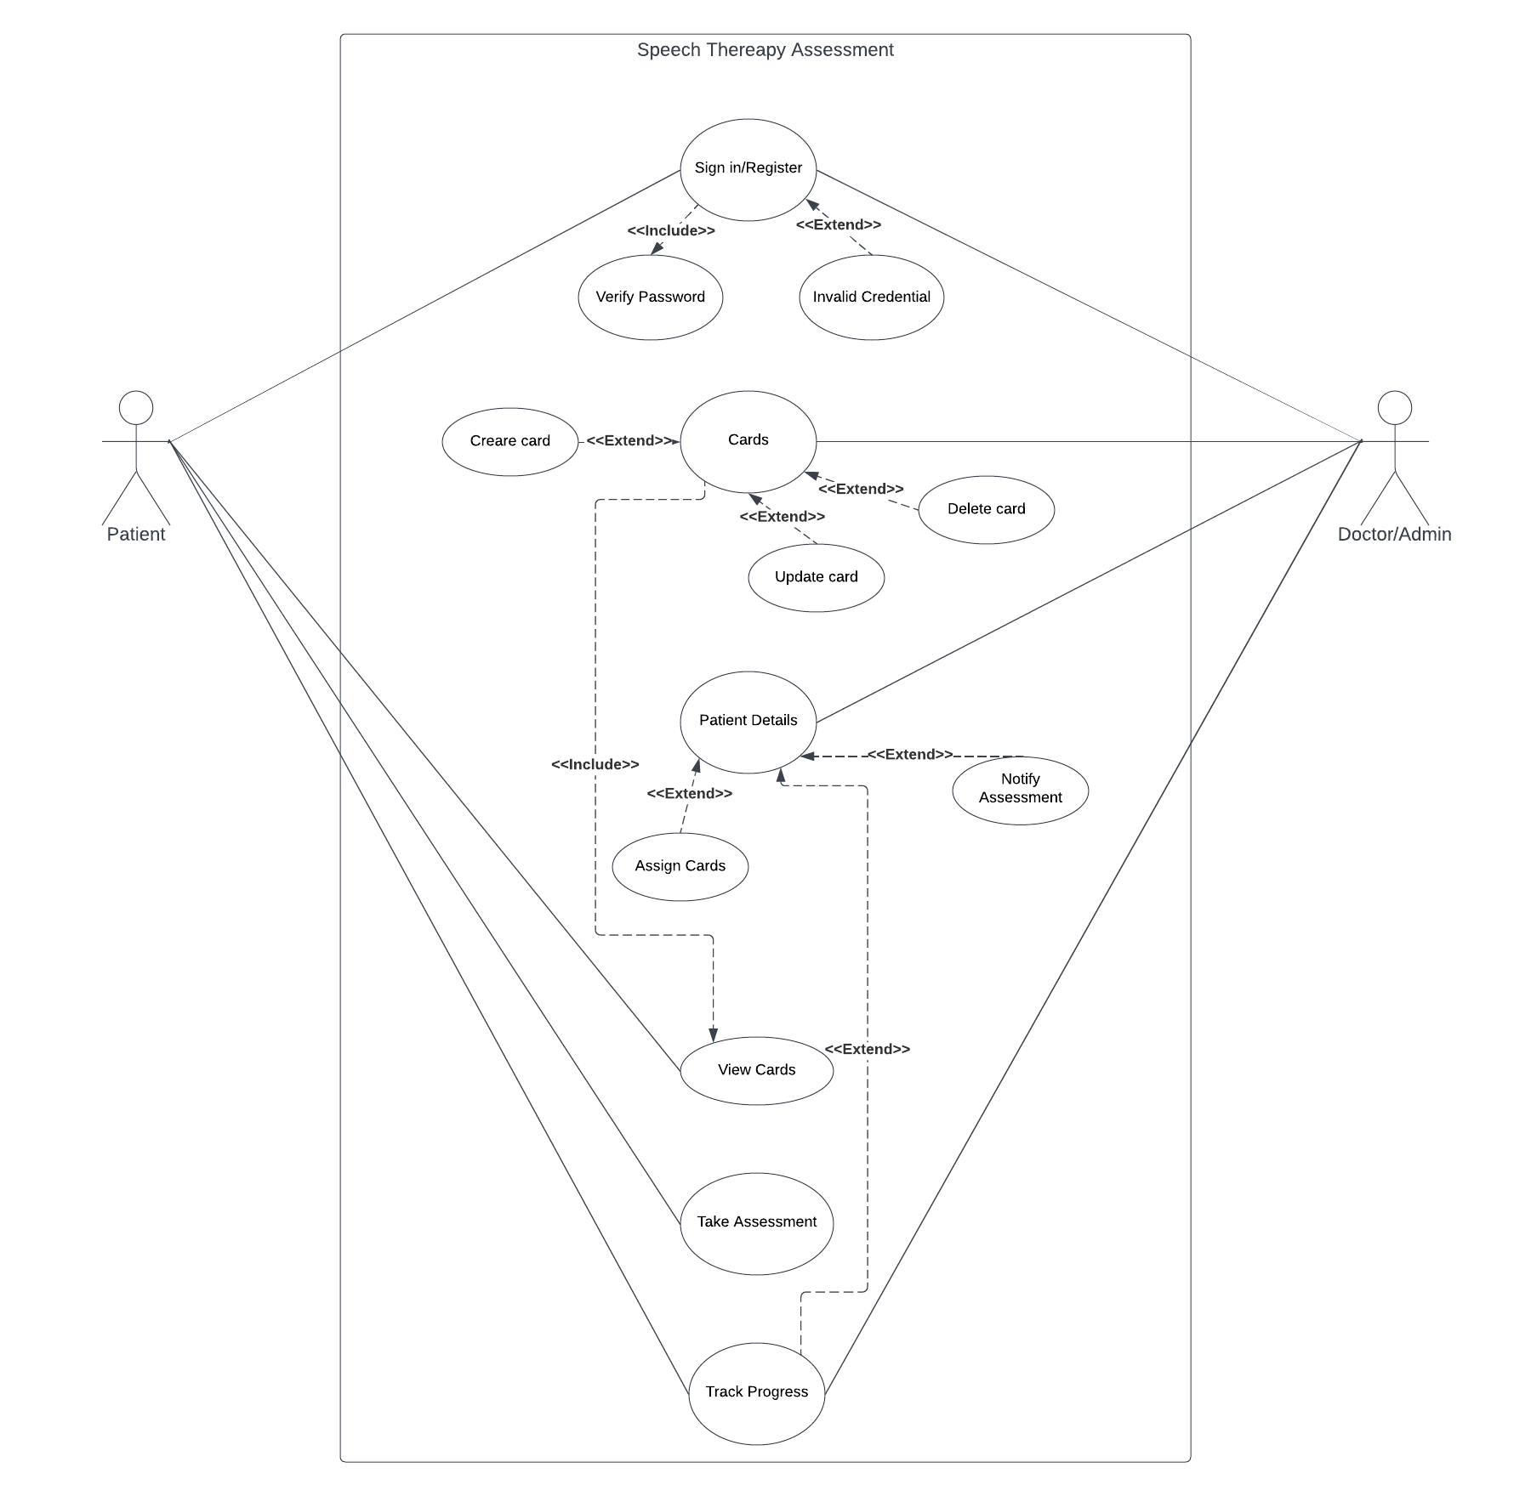
Use Case

Slide 5
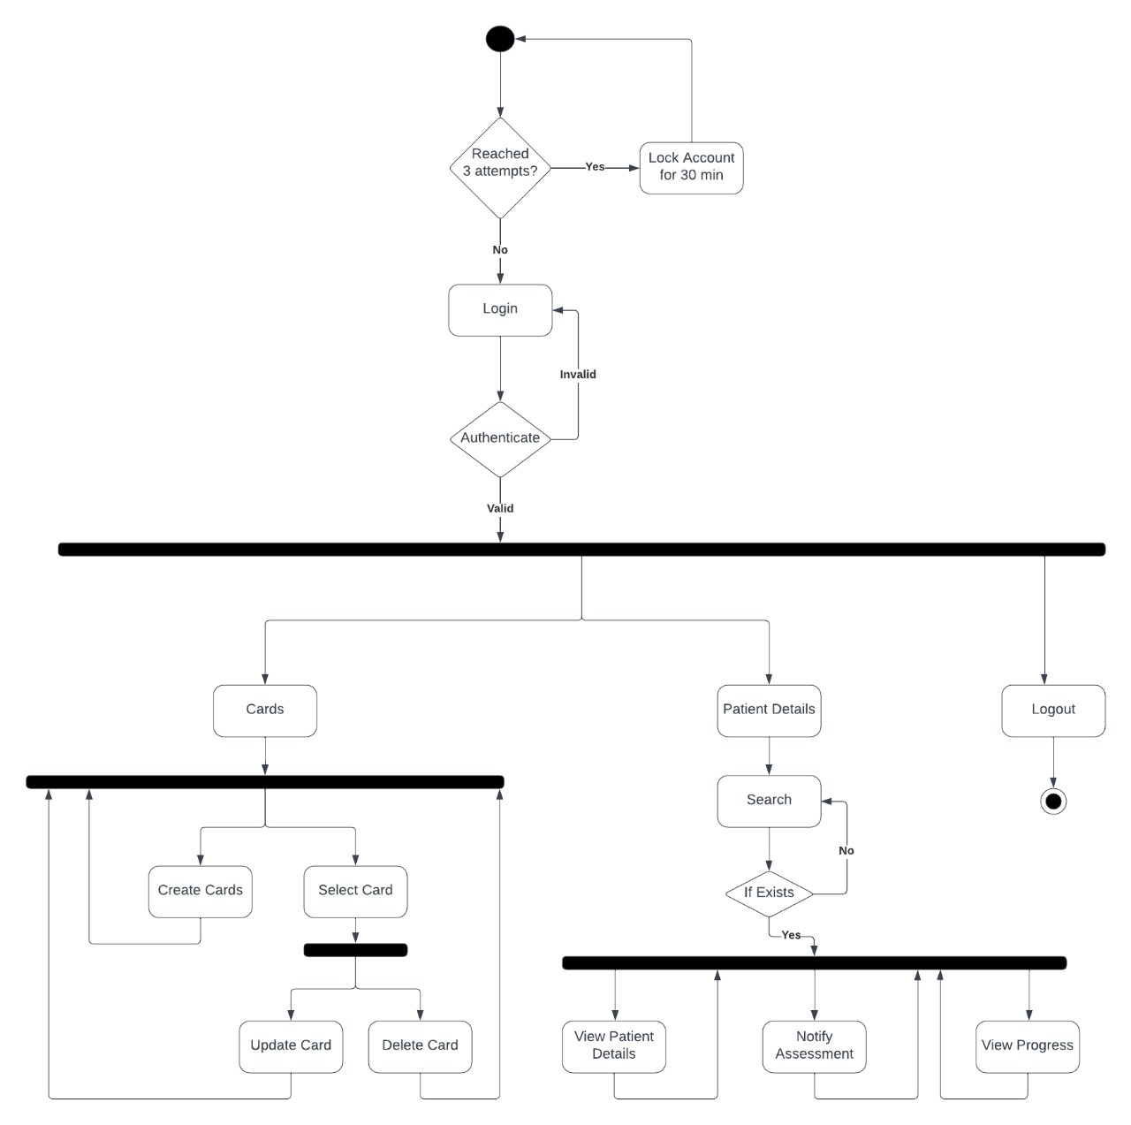
Admin Flow

Slide 6
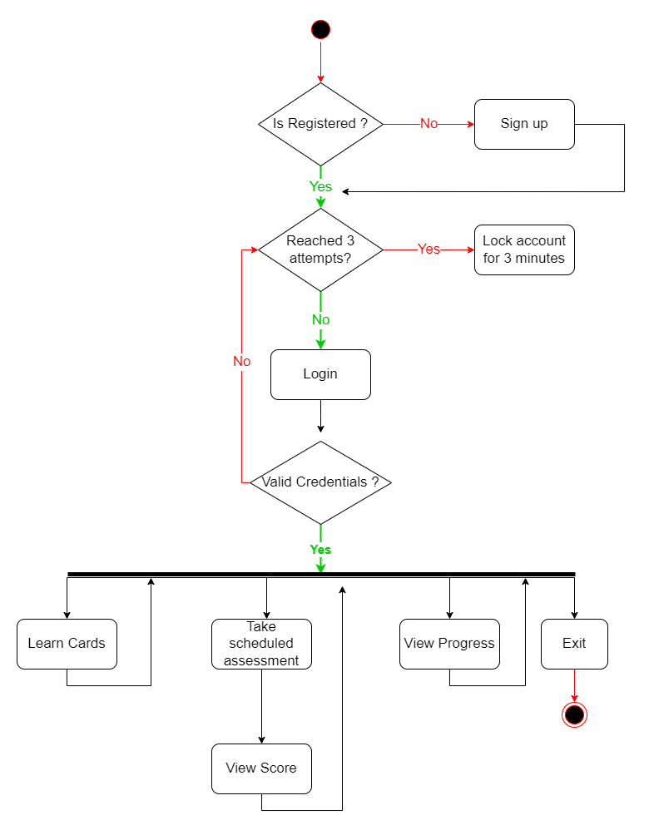
User Flow

Slide 7
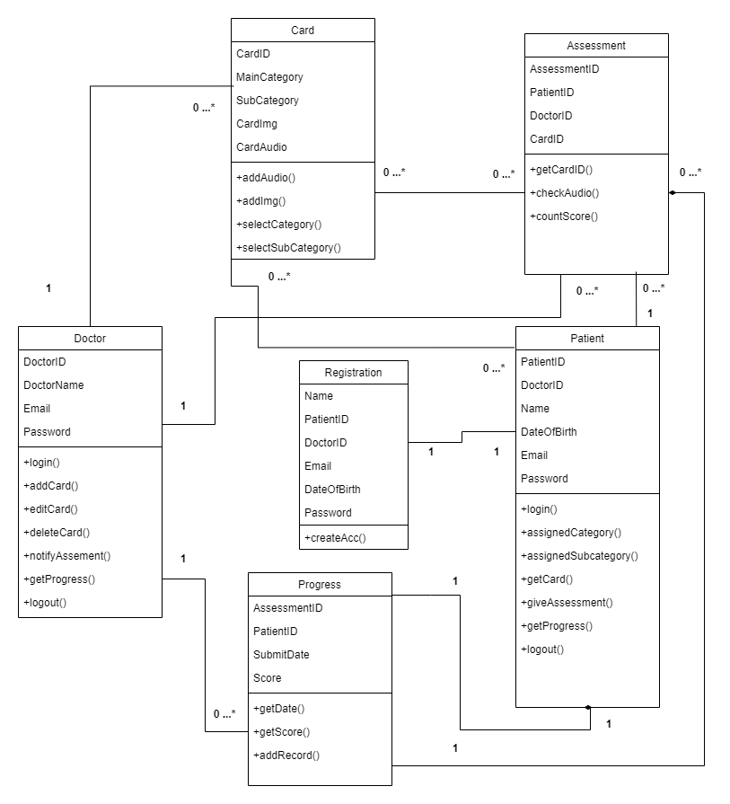
Class Diagram

Slide 8
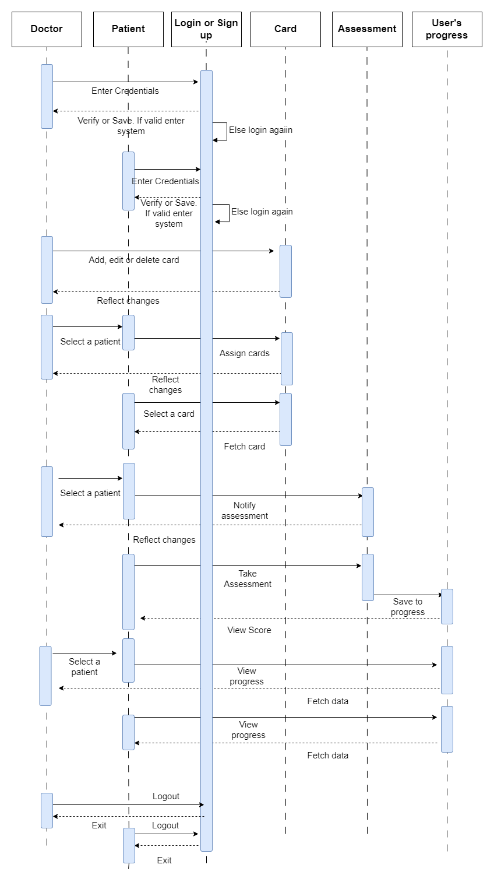
Sequence Diagram

Slide 9
Conclusion
The development of the mobile application for speech therapy targeted at children diagnosed with Autism Spectrum Disorder (ASD) represents a significant stride towards addressing the unique communication challenges faced by this special group of individuals. This project was undertaken with a clear understanding of the pressing need for effective and accessible solutions in the realm of ASD therapy. Traditional speech therapy methods, often hindered by logistical constraints and costs, have been a longstanding challenge for families and caregivers. The inherent variability in ASD symptoms further emphasizes the necessity for personalized interventions.

